Slide 1
AWSML Modeling

Slide 2
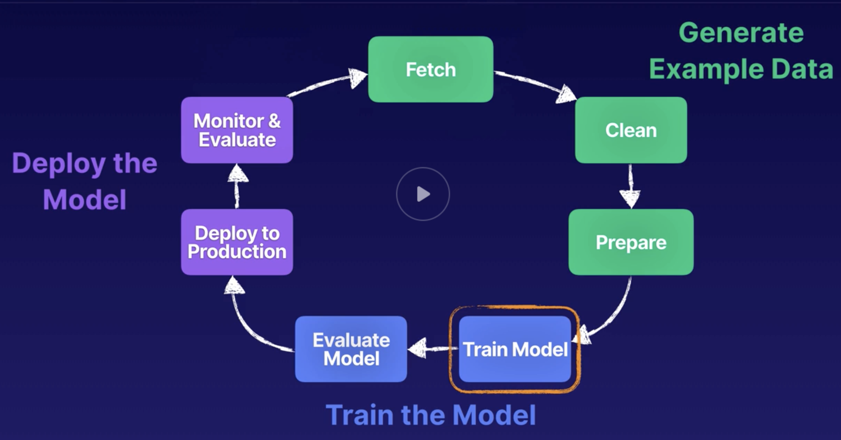
Training model after data cleaning

Slide 3
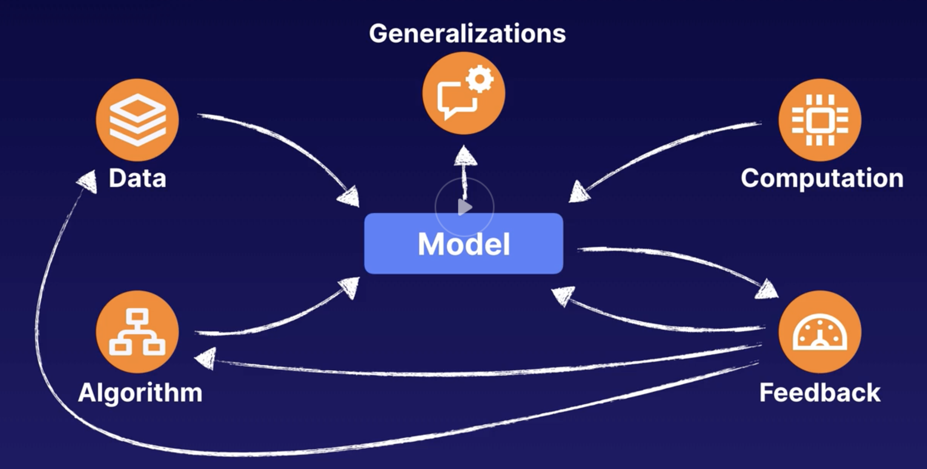
What is a model?
Models can accurately generalize an outcome by using training data (running ML algorithms on data sets) in order to find a solution to a problem or challenge.

Slide 4
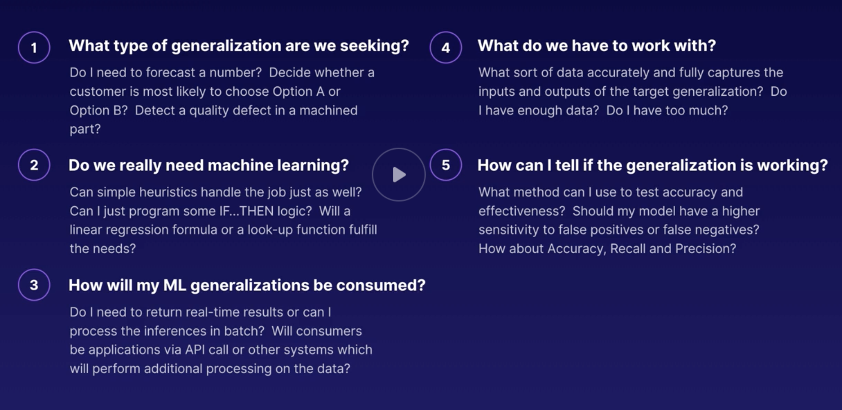
Building a good model

Slide 5
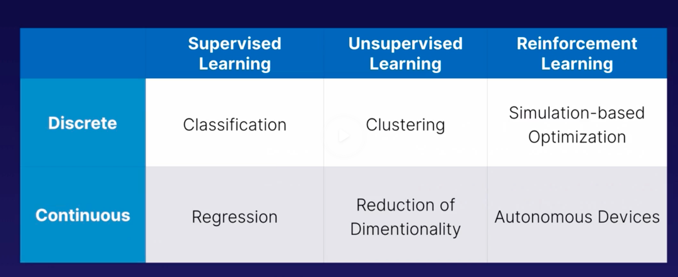
Types of models

Slide 6
Model components
For computation use – AWS
Check if there is enough data
Apply algo on dataset
Feedback metrics

Slide 7
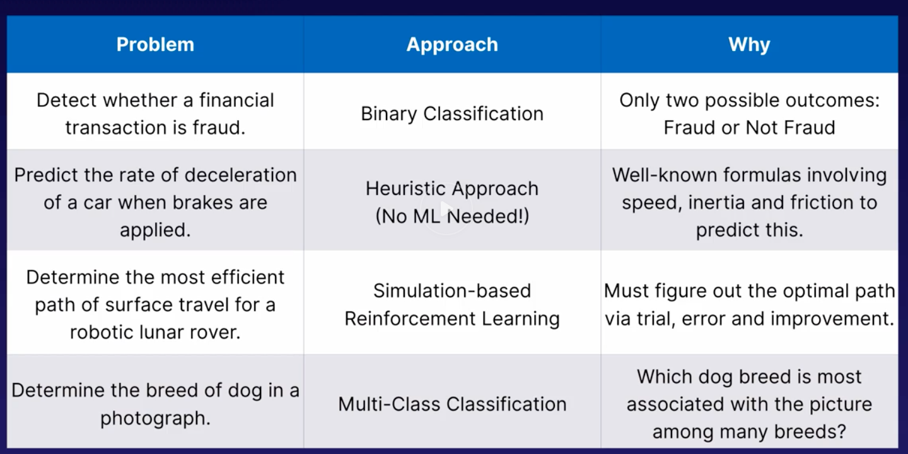
Choosing approach

Slide 8
Cascading algos
Sometimes we may need multiple algos:
Remove outliers – Random cut forest
Identify relevant attributes/features – PCA
Cluster in groups – K-Means
Predict basket size – Linear Learner

